Slide 1

Leader Name: Chaudhari Shubham Rajendra

Slide 2
Idea Introduction
IDEA TITLE- Face recognition at varying angles
Tech Stack
1.Python
2.OpenCV
3.MySql
4. machine learning
Resources Used
1.Visual Studio
2. Web Camera
3.OAK D kit
Any Third Party API/Services used
Yes
(Microsoft API & Google API)
Face recognition at varying angles
Recognition of the people from their face is widely used as it is easy and most natural way. Due to ease of collection without disturbing the subject, it is one of the most popular ways of automatic machine authentication. In automatic face recognition(Deep Neural Algorithm), the first step is to identify the boundary of the face and separate it from the photographed image. Next, recognition algorithm’s step is to extract feature vectors from the input (probe) image. These features are then compared with the set of such features stored in the database. Yes it is possible to identify suspects by varying angle. In these method we use Human Activity Recognition. HAR with analysis of angle between skeletal joint using RGB- depth sensor. Multiple angle face- Image data and computational efficient authentication technique using multilevel perceptron.

Slide 3


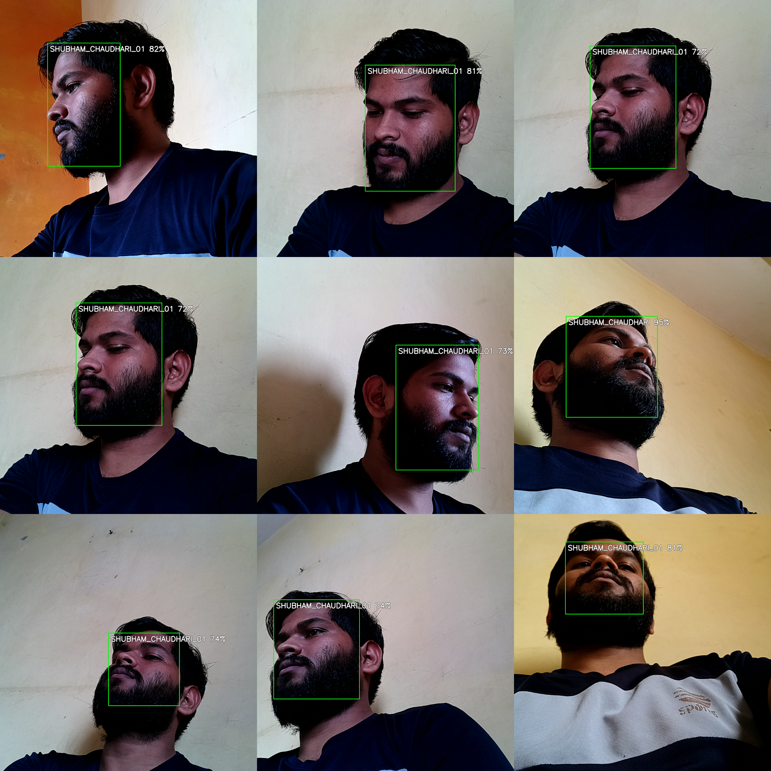
our Approach Towards Idea
Our approach towards the idea
1) This idea will help to identify terror suspects in CCTV feeds.
2) This will also help to identify the faces at varying angles in future .
3)It will also help to recognize the age , skin color and gender with the help of facial structure.
4) It will throw an alert in real time as soon as a suspect is detected.
Main reason why we focused on this problem is that many criminals are escaping from the camera by hiding there half side of face and remain unrecognised and unidentified.
1)Preventing Crime in Retail
2) Increase Accuracy
3)High Accuracy in object Detection And Tacking
1) High resolution Camera
Notes:
Use any image of your proposed solution here instead of this macbook image

Slide 4
Development Pipeline
1.First we have to set the camera in different places.
2.Detect the faces.
3.Scan the faces
4.Extraction
5.Matching with database.
6.Throw an alert
1.Python
2.OpenCv
3.SQL Database
4.Visual Studio
yes ,Third party API used,
1.Microsoft API
2.Googl API
Additional Setup for ResnetSSDFaceDetectionExample : https://raw.githubusercontent.com/opencv/opencv_3rdparty/b2bfc75f6aea5b1f834ff 0f0b865a7c18ff1459f/res10_300x300_ssd_iter_140000.caffemodel.
Proposed UI and functional flow in pointers
1.Login page
2.Camera button
3.Face Capture
4. Face Detect
Step A
Step B
Step C
Step D
Step E

Slide 5
Vision of Innovation/Idea/Solution
Actually, this project aims to track / detect the person (Suspect) from different angles with good resolution camera . Also if the suspect is tracked then processing time must be less in order to thrown an alert to save people ‘s life. At the same time the number of suspects must be detected efficiently without ambiguity.
1.Firstly , we have to set the camera on different places.
2.Detect the various faces.
3.Scan these faces
4.Extraction
5.Matching these faces with existing database.
6.Give Alert message.
The Early stage innovation is Object Detection and identifying the object accurately.
2 Months

